Slide 1
DMAIC PROBLEM SOVING
Mark Wabusela

Slide 2
Overview of the DMAIC Methodology
DMAIC Methodology
Objectives
Background & Introduction
DMAIC
Reviewer Guide
Summary
Mark Wabusela

Slide 3
Objectives
This module will provide the opportunity to:
Understand the DMAIC Methodology
How to review DMAIC projects
Mark Wabusela

Slide 4
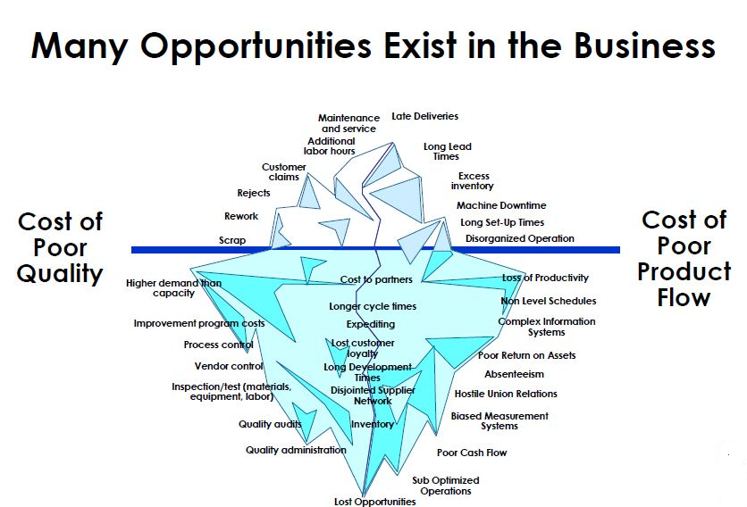
Mark Wabusela

Slide 5
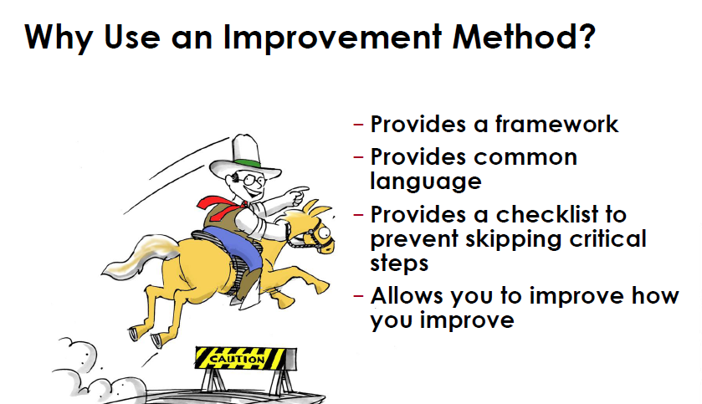
Mark Wabusela

Slide 6
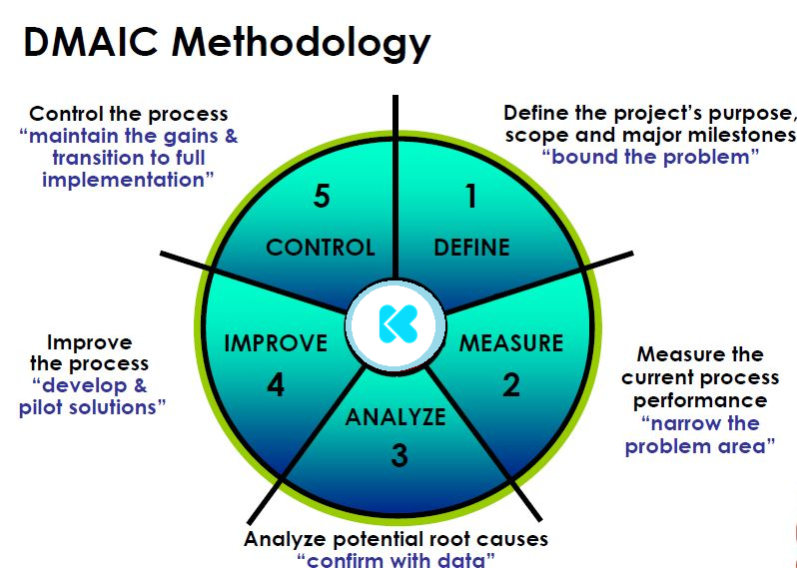
Mark Wabusela

Slide 7
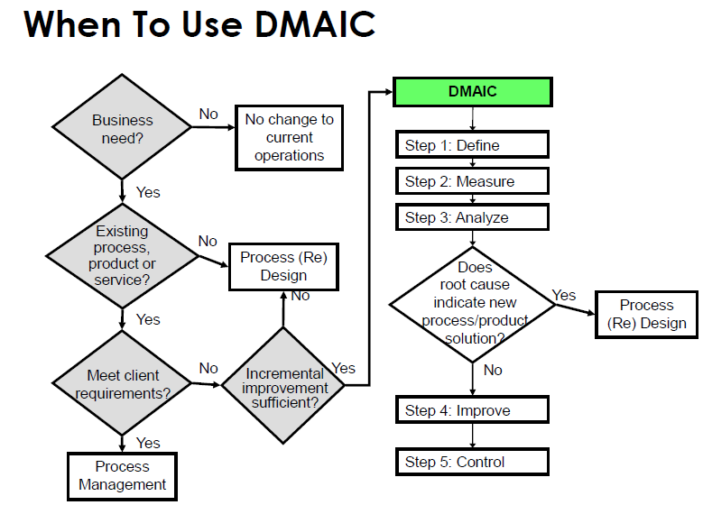
Mark Wabusela

Slide 8
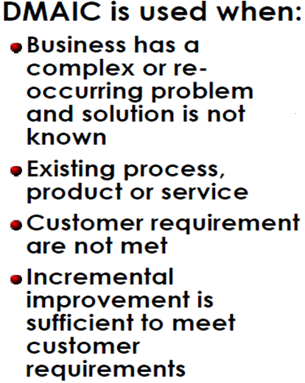
Mark Wabusela

Slide 9

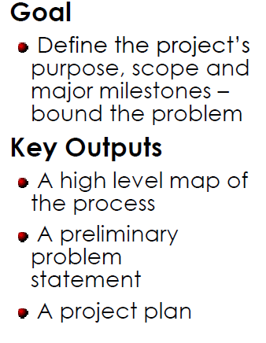
Mark Wabusela

Slide 10

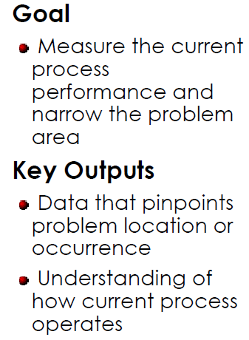
Mark Wabusela

Slide 11

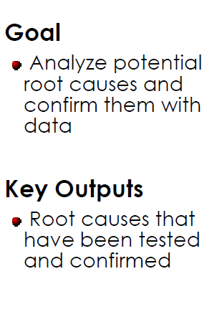
Mark Wabusela

Slide 12

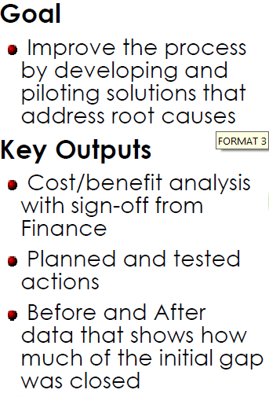
Mark Wabusela

Slide 13

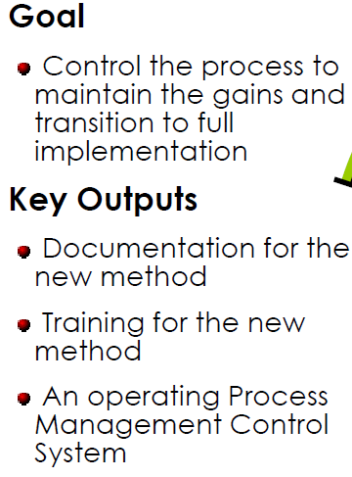
Mark Wabusela

Slide 14
Mark Wabusela

Slide 15
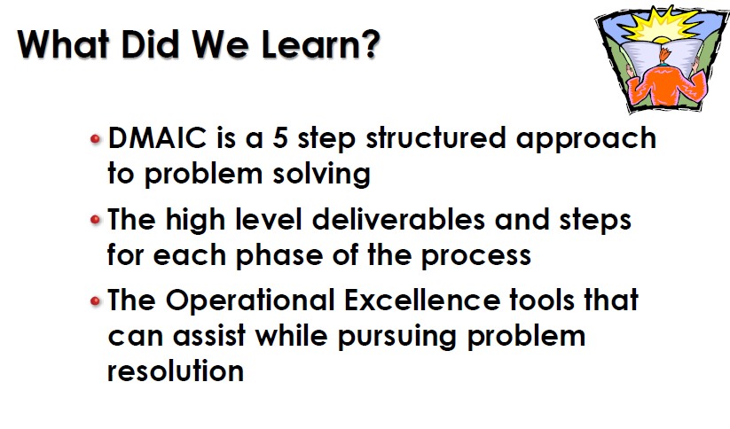
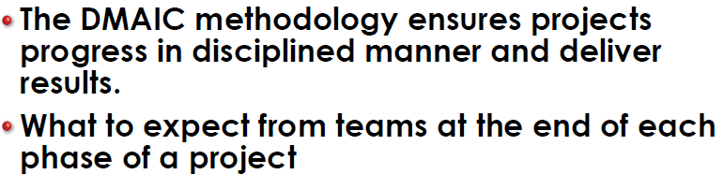
Mark Wabusela

Slide 16
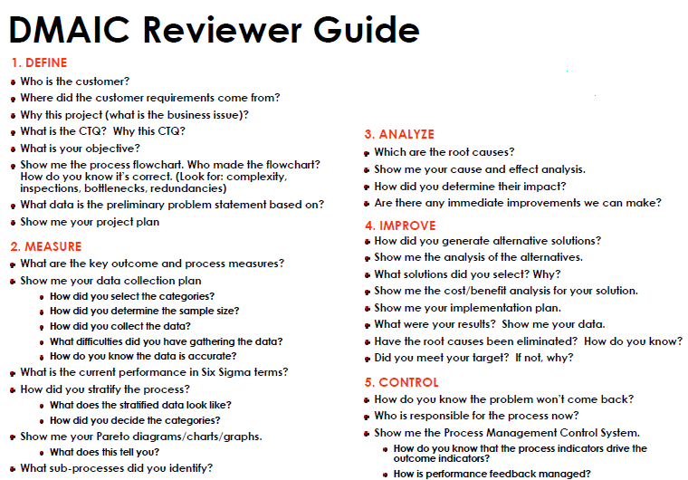
Mark Wabusela

